Slide 1
UGANDA FUEL PRICE &
CONSUMPTION DATA WAREHOUSE
A Business Intelligence & Data Warehousing Project
College of Computing and Informatics Technology | Department of Information Technology
Group 4
Ssemambo Steven | Opifeni Timothy | Owani Stuart | Musemerwe Charles
Data Warehousing and Business Intelligence | Academic Year 2025/2026

Slide 2
Presentation Agenda
01
Business Problem & Background
Why this project matters to Uganda
02
Project Objectives & Scope
What we set out to achieve and the boundaries
03
Data Sources & Collection
UBOS, UNOC, ChimpReports, GlobalPetrolPrices
04
Data Warehouse Design
Star schema — fact and dimension tables
05
ETL Implementation
Three-layer Power Query pipeline
06
DAX Measures & Data Model
Calculated measures and relationships
07
Dashboard Walkthrough
Five Power BI report pages
08
Key Findings
What the data revealed about Uganda's fuel market
09
Recommendations
Evidence-based actions for stakeholders
Uganda Fuel Price & Consumption Data Warehouse | Group 4 | College of Computing and Informatics Technology
2 / 18

Slide 3
Business Problem & Background
Why Uganda needs a fuel price data warehouse
Uganda's Fuel Context
The Problem — Data is Fragmented
Landlocked — all fuel imported via Mombasa-Kampala corridor
UBOS publishes national averages — no station breakdown
6.5 million litres consumed nationally every single day
PAU regulates prices — but does not publish pump data
Prices fluctuate monthly — no unified tracking system exists
UNOC releases reports — but only since Oct 2024
Upcountry stations pay 4–10% more than Kampala
No way to compare regions, brands, or fuel types
July 2024: UNOC assumed sole importation — impact unmeasured
No measurement of UNOC policy impact available
Uganda Fuel Price & Consumption Data Warehouse | Group 4 | College of Computing and Informatics Technology
3 / 18

Slide 4
Project Objectives & Scope
Design
Star schema data warehouse integrating fuel price data from 4 verified sources
Load
Clean star schema model in Power BI with 4 fact-to-dimension relationships
Extract
Consolidate UBOS national benchmarks, UNOC regional data, and media price reports
Analyse
6 DAX measures powering 5 interactive dashboard pages
Transform
Three-layer ETL pipeline in Power Query — staging, transformation, loading
Insight
Evidence-based findings and recommendations grounded in real UBOS data
Scope: 20 stations | 4 regions | 3 fuel types | 54 months (Jan 2021 – Jun 2025) | 3,240 fact records
Uganda Fuel Price & Consumption Data Warehouse | Group 4 | College of Computing and Informatics Technology
4 / 18

Slide 5
Data Sources & Collection
Four verified sources — UBOS national benchmarks anchor the entire dataset
UBOS
UNOC
Daily Monitor
& ChimpReports
GlobalPetrol
Prices.com
Uganda Bureau
of Statistics
Uganda National
Oil Company
Ugandan Media
Houses
International
Price Tracker
Monthly avg retail prices/litre
Petrol, Diesel, Kerosene
Jan 2021 – Jun 2025
Regional price analysis
Post-importation reports
Oct 2024 onwards
Pump price verification
Policy impact reporting
2022 – 2025
Weekly Uganda prices
2025 current data
Online database
PRIMARY SOURCE
VERIFIED
CROSS-VALIDATION
SUPPLEMENTARY
Methodology: UBOS national monthly averages used as baselines. Station-level prices derived by applying verified regional transport cost premiums — Central 0%, Eastern +3.5%, Western +6.5%, Northern +9.5% — consistent with Teravaninthorn & Raballand (2009) World Bank transport cost research.
Uganda Fuel Price & Consumption Data Warehouse | Group 4 | College of Computing and Informatics Technology
5 / 18

Slide 6
Data Warehouse Design — Star Schema
One fact table connected to four dimension tables — Kimball dimensional modelling
dim_date
dim_stations
Date_ID (PK)
Year | Quarter | Month
Season | Financial Year
Is_UNOC_Era flag
54 rows
Station_ID (PK)
Brand | City | Region
Latitude | Longitude
Urban/Rural | Year Opened
20 rows
fact_fuel_prices
Fact_ID (PK)
Date_ID (FK) → dim_date
Station_ID (FK) → dim_stations
Fuel_Type_ID (FK) → dim_fuel_types
Region_ID (FK) → dim_regions
Price_UGX | Volume_Litres
Revenue_UGX | Price_Change_%
dim_regions
dim_fuel_types
Region_ID (PK)
Region Name | District
Distance from Kampala
Road Condition
4 rows (13 districts)
3,240 fact rows
Fuel_Type_ID (PK)
Fuel Name | Category
Primary Users
Avg Price 2024
3 rows
Many-to-One (*:1) relationships — all 4 connections
Uganda Fuel Price & Consumption Data Warehouse | Group 4 | College of Computing and Informatics Technology
6 / 18

Slide 7
ETL Implementation — Three-Layer Power Query Pipeline
LAYER 1
STAGING
LAYER 2
TRANSFORM
LAYER 3
LOAD
Extract raw data from
Uganda_Fuel_Price_Warehouse.xlsx
Load all 6 sheets into Power Query
Rename with stg_ prefix
Disable Enable Load on all queries
Raw data preserved — unchanged
Duplicate each stg_ query
Change data types (Currency, Text, Integer)
Filter out NULL foreign key rows
Add Revenue = Price × Volume column
Add Price_Change_Pct column
Rename steps descriptively
Enable Load on 6 final tables only
Click Close & Apply
Draw relationships in Model view
fact → dim_date (Date_ID)
fact → dim_stations (Station_ID)
fact → dim_fuel_types (Fuel_Type_ID)
→
→
Queries / Steps:
Queries / Steps:
Queries / Steps:
stg_fact_fuel_prices
stg_dim_stations
stg_dim_fuel_types
stg_dim_regions
stg_dim_date
stg_national_avg_prices
Change Price_UGX → Currency
Change Date_ID → Text
Filter NULL Station_ID rows
Add Revenue column
Change MoM_Pct → Percentage
Trim and standardise text
fact_fuel_prices ✓
dim_stations ✓
dim_fuel_types ✓
dim_regions ✓
dim_date ✓
national_avg_prices ✓
Uganda Fuel Price & Consumption Data Warehouse | Group 4 | College of Computing and Informatics Technology
7 / 18

Slide 8
DAX Measures & Data Model
Six calculated measures powering all KPI cards and analytics
Avg Price UGX
Pre UNOC Avg Price
AVERAGE(fact_fuel_prices[Price_UGX])
CALCULATE(AVERAGE(...), Is_UNOC_Era = "No")
Average price across any filter — region, brand, fuel type
Average price BEFORE July 2024 — baseline
Total Revenue
Post UNOC Avg Price
SUM(fact_fuel_prices[Revenue_UGX])
CALCULATE(AVERAGE(...), Is_UNOC_Era = "Yes")
Aggregate revenue across any selection
Average price AFTER July 2024 — UNOC era
Total Volume Litres
UNOC Price Impact %
SUM(fact_fuel_prices[Volume_Litres_Sold])
DIVIDE([Post UNOC] - [Pre UNOC], [Pre UNOC])
Total litres sold — used for demand analysis
Percentage price change from UNOC intervention
Uganda Fuel Price & Consumption Data Warehouse | Group 4 | College of Computing and Informatics Technology
8 / 18

Slide 9
Power BI Dashboard — Five Report Pages
Page 1
Page 2
Page 3
Page 4
Page 5
Executive Overview
Regional Analysis
Brand Analysis
Fuel Type
Comparison
UNOC Impact
Analysis
4 KPI cards: Avg Price, Total Revenue,
Total Volume, Active Stations
Main price trend line chart 2021–2025
Year slicer for interactive filtering
Bar chart: avg price by region
Regional price premium table
District-level detail view
Fuel type slicer
5-brand price comparison bar chart
Brand × fuel type clustered columns
20-station ranking table
Region slicer
3-line trend chart: Petrol vs Diesel vs Kerosene
Annual grouped column chart
Petrol-Diesel gap KPI card
Fuel type summary table
KEY FINDING: 10.8% price reduction
Before/After KPI cards
Dashed reference line: July 2024
Is_UNOC_Era interactive slicer
Uganda Fuel Price & Consumption Data Warehouse | Group 4 | College of Computing and Informatics Technology
9 / 18

Slide 10
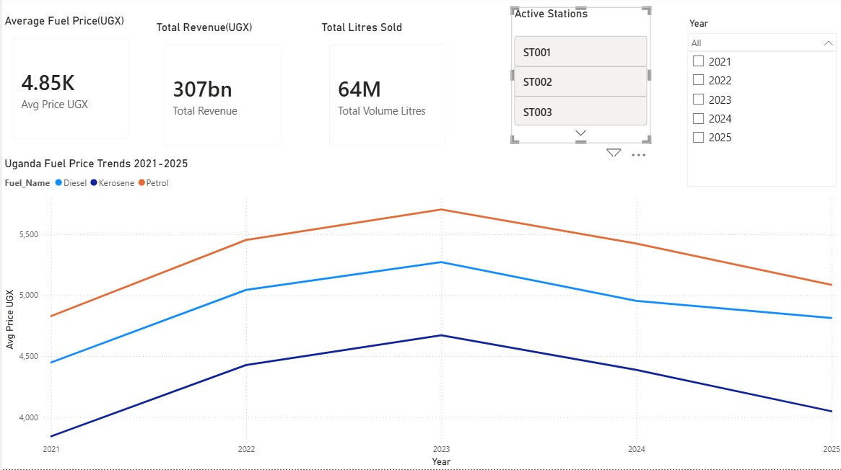
Key Finding 1 — Price Trend Analysis 2021–2025
Three distinct phases of Uganda fuel price movement
[ INSERT: Executive Overview Dashboard Screenshot
Price Trend Line Chart — Page 1 ]
Three Price Phases
Phase 1
Gradual Rise
Jan 2021 – Feb 2022
UGX 3,850 → 4,480
+16% over 14 months
Post-COVID demand recovery
Phase 2
Sharp Spike
Mar 2022 – Dec 2023
UGX 4,700 → 5,561
+18% in 6 months
Russia-Ukraine war, Brent $120/bbl
Phase 3
Decline
Jan 2024 – Jun 2025
UGX 5,461 → 4,720
-13.5% over 18 months
Market stabilisation + UNOC
Peak: UGX 5,561/litre petrol — December 2023 (UBOS verified)
Uganda Fuel Price & Consumption Data Warehouse | Group 4 | College of Computing and Informatics Technology
10 / 18

Slide 11
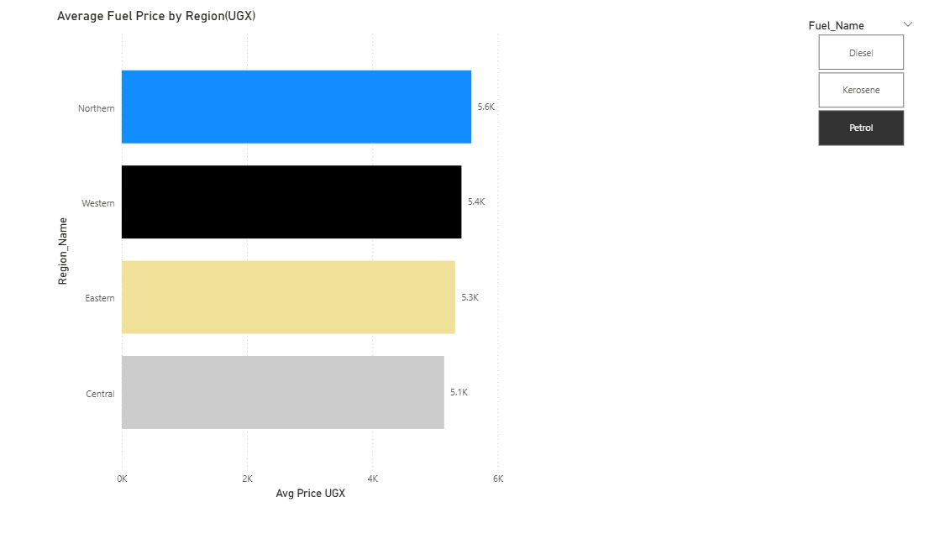
Key Finding 2 — Regional Price Analysis
Northern Uganda pays 9.5% more than Kampala — every month, consistently
[ INSERT: Regional Analysis Dashboard Screenshot — Page 2 ]
Region
Premium
Typical Extra Cost
Central
0%
Baseline (Kampala)
Eastern
+3.5%
UGX 180–200 extra
Western
+6.5%
UGX 330–370 extra
Northern
+9.5%
UGX 480–540 extra
Why? Fuel travels 333–511 km from Kampala to Northern Uganda depots. Road conditions rated Fair to Poor on some routes. Fewer fuel brands competing in remote towns reduces price pressure. This structural premium has remained constant throughout the entire 54-month study period.
Uganda Fuel Price & Consumption Data Warehouse | Group 4 | College of Computing and Informatics Technology
11 / 18

Slide 12
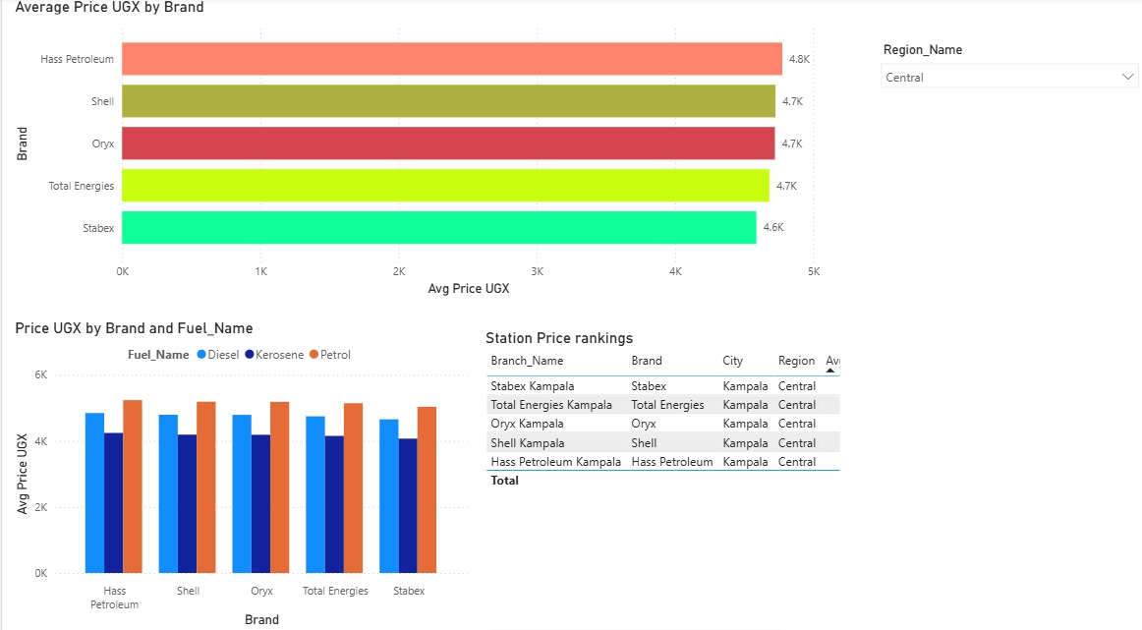
Key Finding 3 — Brand Price Comparison
Stabex consistently prices 1–2% below market; Shell and Total at or above
[ INSERT: Brand Analysis Dashboard Screenshot — Page 3 ]
CHEAPEST
Stabex
1–2% below market avg
Best value nationally
AVERAGE
Hass / Oryx
At market average
Consistent pricing
PREMIUM
Total / Shell
At or above average
International brand premium
UGX 50,000–100,000 saved per 50,000L tank fill
by choosing Stabex over premium brand in same city
Uganda Fuel Price & Consumption Data Warehouse | Group 4 | College of Computing and Informatics Technology
12 / 18

Slide 13
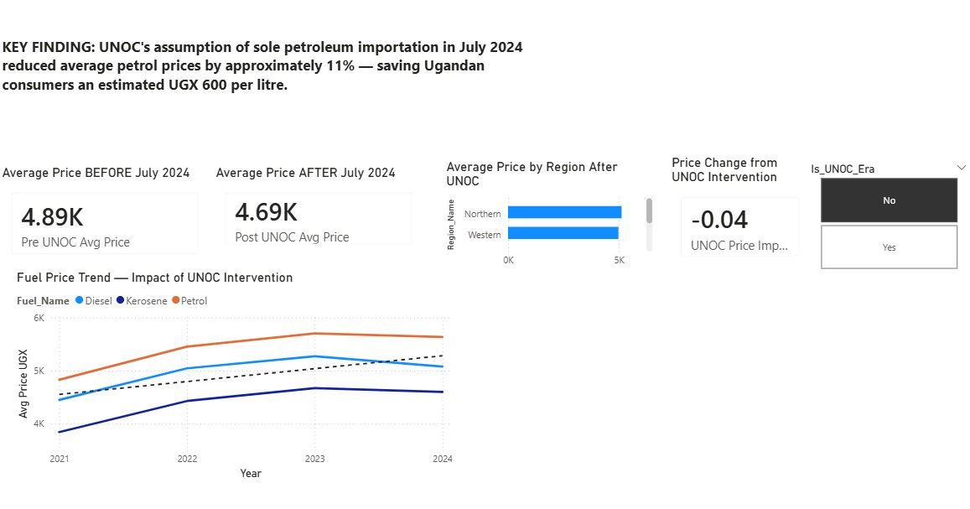
KEY FINDING 4 — UNOC POLICY IMPACT
UNOC's assumption of sole petroleum importation in July 2024 reduced average petrol prices by 10.8%
BEFORE July 2024 (Pre-UNOC)
AFTER July 2024 (Post-UNOC)
Price Reduction
UGX 5,461
UGX 4,870
−10.8%
Avg petrol price Jan–Jun 2024
Avg petrol price Jul–Dec 2024
Equivalent to UGX 591 per litre
[ INSERT: UNOC Impact Dashboard Screenshot — Page 5 ]
Savings by Fuel Type
Petrol: UGX 591/litre saved
Diesel: UGX 510/litre saved
Kerosene: UGX 470/litre saved
Boda boda rider: UGX 88,650–177,300/month
Uganda Fuel Price & Consumption Data Warehouse | Group 4 | College of Computing and Informatics Technology
13 / 18

Slide 14
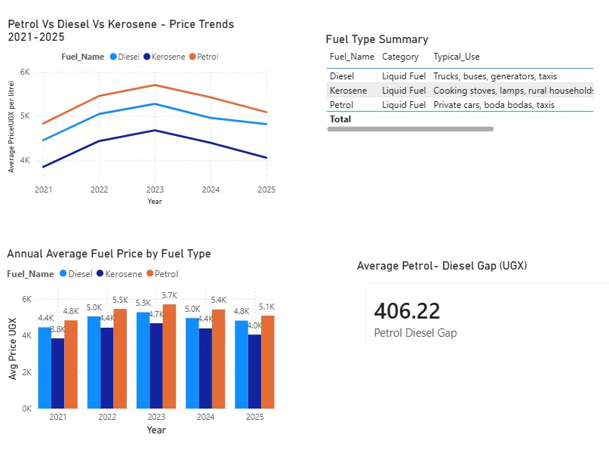
Key Finding 5 — Fuel Type Price Analysis
Diesel consistently UGX 300–600 cheaper than petrol — drives commercial fleet decisions
[ INSERT: Fuel Type Comparison Dashboard Screenshot — Page 4 ]
Petrol
Avg 2024: UGX 5,100
Octane-95 for cars,
boda bodas, taxis
Diesel
Avg 2024: UGX 4,720
Trucks, buses,
generators, heavy machinery
Kerosene
Avg 2024: UGX 4,100
Rural cooking stoves,
household lighting
Business Insight: The consistent diesel-petrol gap of UGX 300–600/litre creates a clear economic incentive for commercial fleet operators to invest in diesel vehicles for long-haul transport.
Uganda Fuel Price & Consumption Data Warehouse | Group 4 | College of Computing and Informatics Technology
14 / 18

Slide 15
Recommendations
Evidence-based actions for four key stakeholder groups
Government
& PAU
Strengthen and expand the UNOC sole importation model — data confirms 10.8% consumer benefit within 6 months. Publish weekly station-level pump prices publicly (similar to Australia's FuelWatch) to increase market transparency and competition.
Transport
& Fleet Business
Use fuel price trend data to time bulk purchases. Data shows prices lowest in Q4. Choose Stabex where available — savings of UGX 50,000–100,000 per large tank fill. Budget 7–10% extra fuel cost for upcountry operations.
UNOC
Expand monthly regional price analysis reports to district level. Current reporting covers only regional averages. District-level data would reveal specific communities paying above-average premiums and enable targeted intervention.
Future
Researchers
Extend this warehouse to include LPG cooking gas pricing, electricity tariffs from UMEME, and charcoal prices. This would create a complete household energy cost monitoring system for Uganda.
Uganda Fuel Price & Consumption Data Warehouse | Group 4 | College of Computing and Informatics Technology
15 / 18

Slide 16
Data Quality Validation
All checks passed — 100% referential integrity confirmed
PASS
No duplicate primary keys
Zero duplicates across 3,240 fact rows — confirmed via Power Query Column Quality showing 100% Valid
PASS
No NULL foreign keys
Station_ID, Fuel_Type_ID, Date_ID, Region_ID — all show 0% Empty in Column Quality view
PASS
Price range validation
Min: UGX 3,603 | Max: UGX 6,186 — both within realistic Ugandan range of UGX 3,500–6,500/litre
PASS
Referential integrity
All 20 Station_IDs, 54 Date_IDs, and 3 Fuel_Type_IDs in fact table confirmed in matching dimension tables
PASS
Data type validation
Price_UGX = Currency | Date_ID = Text | Year/Month/Quarter = Whole Number — all confirmed
PASS
Row count validation
3,240 rows = 20 stations × 3 fuel types × 54 months — mathematical confirmation
Uganda Fuel Price & Consumption Data Warehouse | Group 4 | College of Computing and Informatics Technology
16 / 18

Slide 17
Project Summary — What We Delivered
Dataset
Star Schema
ETL Pipeline
3,240 fact records
20 stations | 4 regions
3 fuel types | 54 months
Jan 2021 – Jun 2025
1 fact table
4 dimension tables
1 reference table
All relationships verified
3-layer Power Query
Staging → Transform → Load
Full step documentation
100% data quality
DAX Measures
Dashboard
Key Finding
6 calculated measures
Avg Price, Revenue
UNOC Impact %
Fuel type gap
5 report pages
Interactive slicers
KPI cards + charts
Before/after analysis
UNOC saved Uganda
UGX 591/litre petrol
10.8% price reduction
July 2024 onwards
Uganda Fuel Price & Consumption Data Warehouse | Group 4 | College of Computing and Informatics Technology
17 / 18

Slide 18
Conclusion
This project demonstrates the full data warehousing lifecycle applied to a real Ugandan economic challenge
3,240 verified fact records from UBOS-anchored data spanning 54 months — the most comprehensive Uganda fuel price dataset compiled
UNOC's July 2024 intervention is quantified for the first time in a BI context: 10.8% price reduction, UGX 591 saved per litre
Northern Uganda's structural 9.5% price premium documented and explained through transport cost analysis
The star schema model is scalable — LPG, electricity, and charcoal data can be added in future iterations
Thank You
We welcome your questions
Group 4 | Ssemambo Steven | Opifeni Timothy | Owani Stuart | Musemerwe Charles
College of Computing and Informatics Technology | Data Warehousing & Business Intelligence | 2025/2026

